Slide 1
Advice-Seeking Network of a Pre-Professional Business Club at an Elite Private University
Cathy Zhuang, Christine Zhou, Julanna Zhang

Slide 2
Introduction
Question: What factors impact the advice-seeking network of a pre-professional business club at an elite private university in the U.S.? Methods:
Sent the survey in group chat with a list of all members, asked them to nominate no more than 10 people that they actively seek advice from (any type of advice)
Also asked for their graduation year, whether they were a BBA major, their position in the club, and whether they live in on-campus or off-campus housing
People that did not respond were not included in the network
1
Notes:
ran ERGM, analyzed cliques and structural similarities, as well as brokerage index

Slide 3
Results
1
2
Centrality
Year and level in club are more associated with degree centrality than BBA or housing
Cliques
Three cliques with three or more members (4, 20, 25 in 4-5 group members)
Randomized Network Comparison
There is significantly more transitivity in this network than there is in randomized networks
Brokerage
Actors with the highest brokerage power: 4, 20, 5, 25, and 15
Brokerage index is positively correlated with betweenness at 0.82 overall
Members that are more important to the flow of the network tend to also have more brokerage power
Notes:
CENTRALITY
The correlations among centrality measures are positive and high, with closeness centrality being slightly lower than the rest, but still positive. This means that a member with a high centrality in one measure of centrality will most likely have high centrality in other measures of centrality. In other words, a member with more ties will most likely have other ways that they are more connected to the network, such as being more connected to important alters.
The graduation year of the individual along with highest position held in the club impact the centrality of a member more than if they are bba or live on/off campus
BBA slightly higher than 0, more likely to be asked questions. However, since we have more BBAs than non-BBAs in our population, this may be confounded by how there are more BBAs
The year equals 2.1, which means that the higher the individual’s year level, the more likely they are to be asked for advice and be central to the network
The level in the organization is 2.16, so the higher one’s status in the club, the more likely they are to be central
Housing is -0.75, meaning that people who live off-campus (1) are less likely to be central to the network
RANDOM NETWORK COMPARISON
We see higher transitivity for the network than randomized networks. This means that in our network of members, the proportion of transitive triangles out of possible triangles is significantly higher than in randomized networks. The transitivity is therefore significantly different from what we would get purely by chance. The density of our network appears to be about the same as that of randomized networks; the proportion of all member ties out of all possible member ties is about the same as that of randomized networks. The centralization is overall higher compared to randomized networks but is not higher than all the results in randomized networks. This means overall the extent to which ties are concentrated is higher but not statistically significant enough to rule out chance. The mutuality of our network also appears to be about the same as that of a randomized network; the proportion of ties that are reciprocated are around the same as that of randomized networks.
BROKERAGE
Actors with the highest brokerage power: 4, 20, 5, 25, and 15. They served the most times as a broker total. Our brokerage index is positively correlated with betweenness at 0.82 overall. This means that the faculty members that are more important to the flow of the network tend to also have more brokerage power.

Slide 4
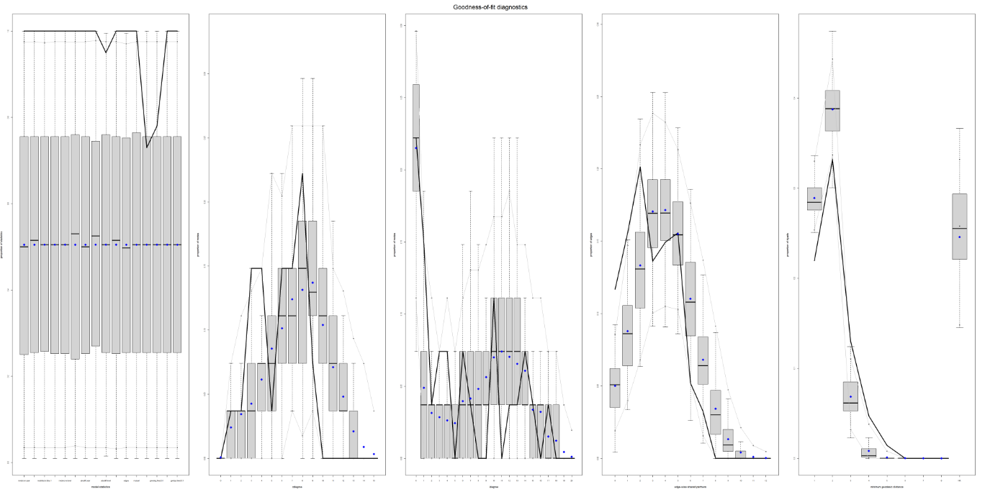
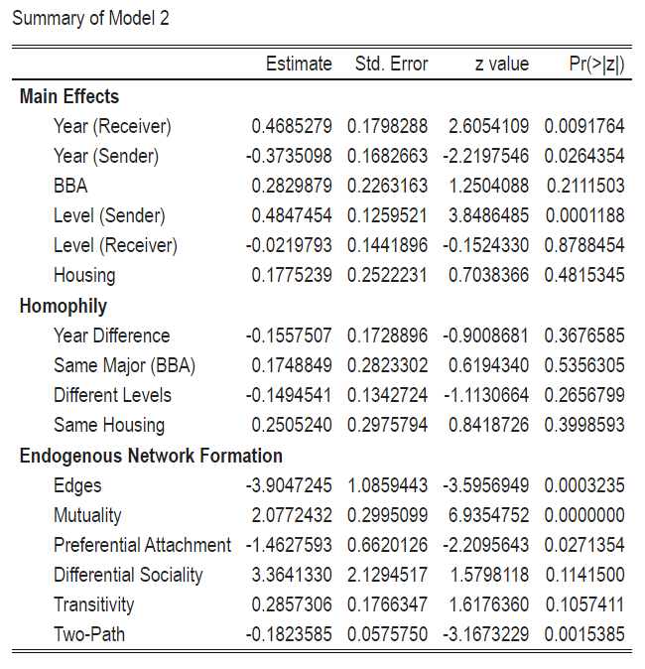
Results
3
Notes:
Model 2 has a smaller AIC (550 compared to 628). Of the statistically significant results, older members are more likely to receive and less likely to send out nominations. Increasing the age by one year is associated with an increase in the odds of receiving a tie by e^0.4685 - 1 = around 60% and a decrease in the odds of sending a tie by e^-0.3735 - 1 = around 31%.
Members of higher levels are more likely to send out ties. Increasing the level by 1 is associated with an increase in the odds of sending out a tie by e^.4847 - 1 = around 62%. None of the homophily measures were statistically significant, meaning we cannot conclude that members of the same year, major, level, or housing situation were more likely to seek advice from one another. The negative coefficient on edges indicates that the network is sparser than expected by chance. There is also significant mutuality in tie formations. The odds for a tie to form a mutual relation is e^2.077 = around 7 times the odds for a tie to form a non-mutual relation. The negative coefficient for preferential attachment indicates ties are more likely to concentrate on a few nodes. The negative coefficient on two-path indicates ties are less likely to form open triangles.

Slide 5
Discussion
4
Possible selection bias
People who did not respond could have something in common
This club has a very rigorous application process -> social controlling?
Current network flaws
Levels analysis may be misleading because we only asked for the single highest position each member has held before
Similarly, BBA is a measure of current status, so there is information not captured in our network, such as pre-BBAs and the higher rate of BBAs in business clubs
Had to force MPLE on ERGM
Additional attributes & considerations
Strength of ties
Racial identification
Gender
Having a job/internship
Industry of job/internship

